Slide 1


Oracle Order Management Implementation for the Food Industry
Thanks to Our instructor Eng. Mostafa
Thanks to Next Academy

Slide 2

TEAM MEMBERS
01
21040671
Salma Yosry
02
21016039
Rozaline Ramy
03
21022688
Nermin Fawzy
04
00000000
Lojain Ali
05
21041056
Menna Ahmed
06
00000000
Ahmed Ashraf

Slide 3


PROJECT OVERVIEW & GOALS
Improve Order Accuracy
Streamline Order-to-Cash Process
Track Inventory and Shelf-Life
Enhance Customer Satisfaction
Reduce Waste
Ensure that orders are processed quickly and with minimal errors.
Automate the O2C cycle, from order entry to invoicing, for smoother operations.
Implement features to manage inventory by lot, batch number, and expiration date to prevent
stockouts and waste.
Ensure timely delivery and accurate orders to improve customer experience
Manage product shelf life effectively to minimize expired stock and associated losses.

Slide 4
BUSINESS REQUIREMENTS
Functional Requirements
Technical Requirements:
Order Processing: Automate and streamline the order-to-cash process, including order entry, processing, fulfillment, and invoicing.
Inventory Management: Implement features for tracking inventory by lot/batch number, shelf life management.
Pricing and Discounts: Different pricing for each Customer and Port of Destination.
Order Types: Export and Local.
Delivery & Logistics: Integration with logistics to meet delivery time constraints.
Returns and Quality Control: Develop processes for managing returns, handling defective products, and ensuring product
Reports: Inventory On-hand, Sales Order Tracking

Slide 5

USER RESPONSIBILITIES IN THE O2C CYCLE
HERE’S A DIAGRAM ILLUSTRATING THE USER RESPONSIBILITIES IN THE ORDER TO CASH (O2C) CYCLE. EACH STAGE SHOWS THE RESPECTIVE USER ROLES AND RESPONSIBILITIES THROUGHOUT THE PROCESS.
Check stock availability ,and Book Sales Order -Logistic Staff
Billing and Invoicing - Accounts Receivable
Create Sales Order Sales Rep
Order Fulfillment - Warehouse Staff

Slide 6
IMPLEMENTATION PLAN OVERVIEW
(TIMELINE START DATE: SEPTEMBER 09, 2024 END DATE: SEPTEMBER 19, 2024)
Phase
1
Phase
2
Phase
3
Phase
4
Phase
5
Phase
6
Planning and Requirements Gathering (3 days)
System Design and Configuration (3 days)
Development and Integration (0 days)
Testing (1 days)
Training and Go-Live (2 days)
Go-Live and Support (1 days)

Slide 7
Points | Before Oracle OMS Implementation | After OMS Implementation
Customer Places an Order | Manually via phone or email | Through an integrated system
Order Verification | Sales team checks inventory manually, often outdated | Real-time inventory data across multiple warehouses
Order Fulfillment | Warehouse picks items manually, increasing human errors | Automatically generated picking lists; barcode scanning reduces errors
Delivery and Shipment | Manually scheduled, leading to delays | Integrated logistics with optimized delivery routes
Inventory Updates | Manually updated after orders are processed | Real-time inventory visibility and automatic stock replenishment
DEMO OVERVIEW
Live Demo of Oracle Order Management: Tailored for the food distribution industry.

Slide 8
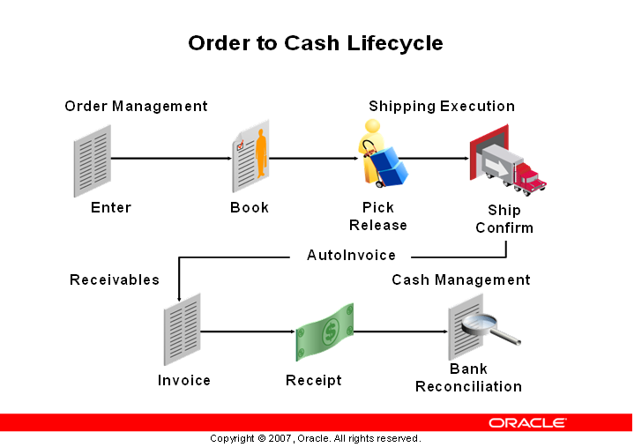

Slide 9






ORDER CREATION PROCESS
STEP-BY-STEP PROCESS FOR CREATING AN ORDER
Step 2
Step 4
Step 6
Create Price List
Enter customer information (name, contact details, address).
Confirm and save the order
01
02
03
04
05
06
Step 1
Step 3
Step 5
Create Three Customer (Test Customer Export EUR. Test Customer Export USD, and Test Customer Local)
Create New Orde
Input order details (product name, quantity, delivery preferences).

Slide 10
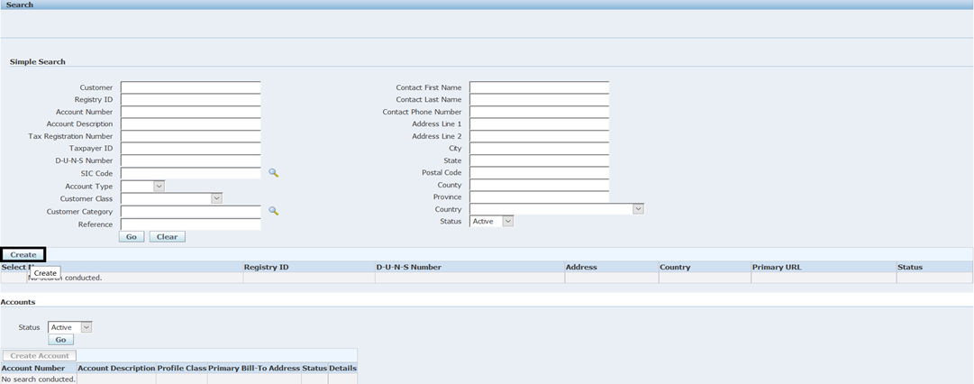
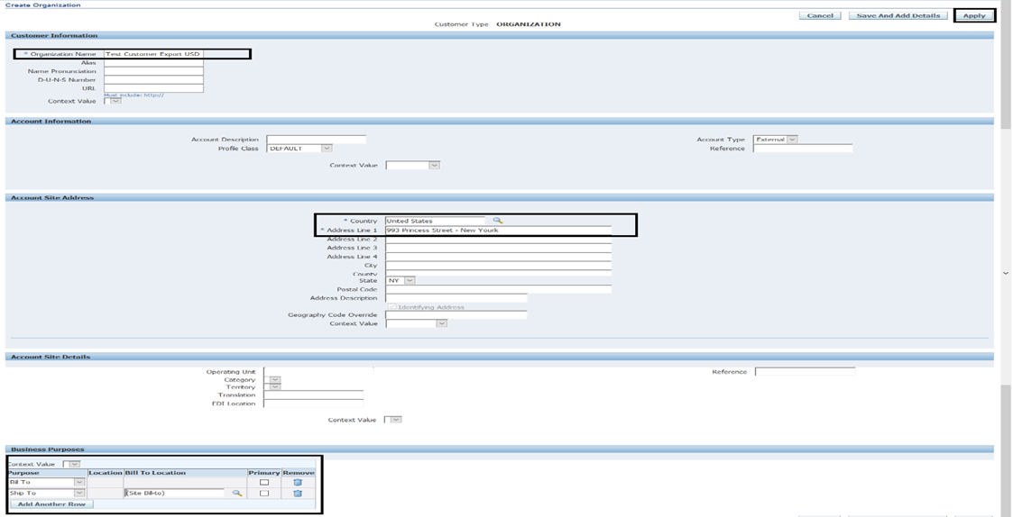
PROCESS FOR CREATING AN ORDER

Slide 11
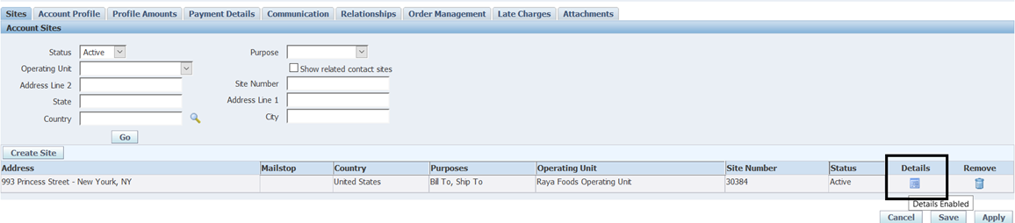
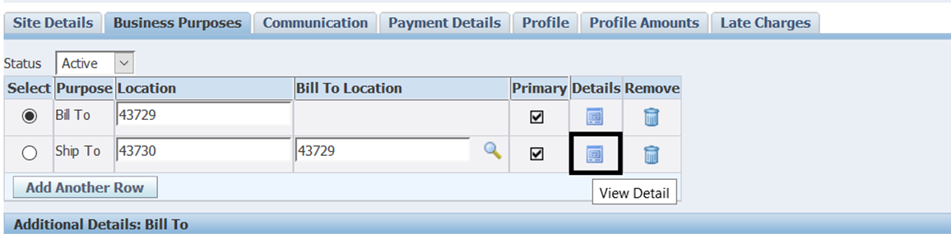
PROCESS FOR CREATING AN ORDER

Slide 12
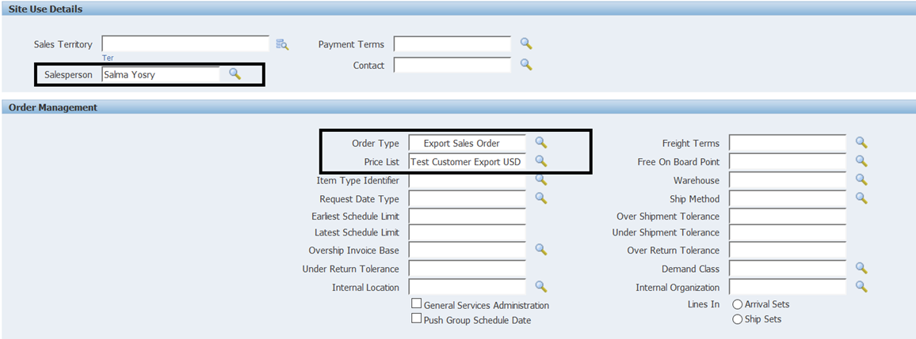
PROCESS FOR CREATING AN ORDER

Slide 13
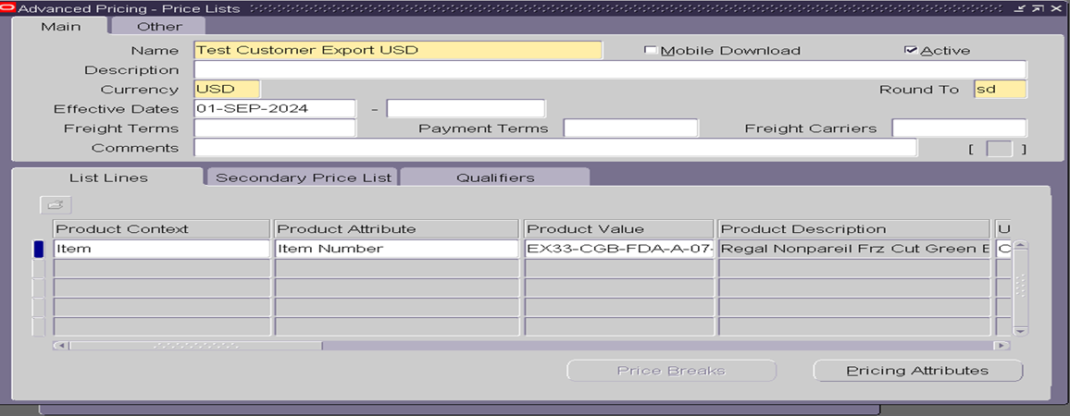
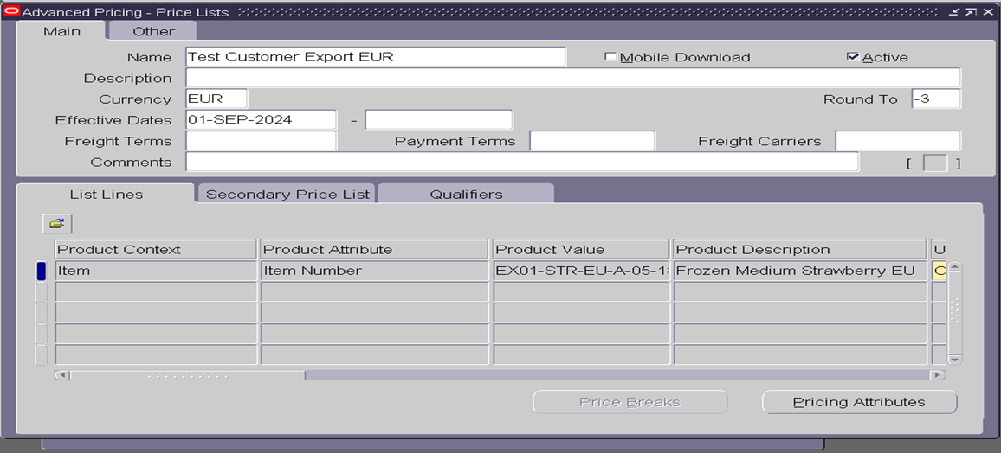
CREATE PRICE LIST

Slide 14
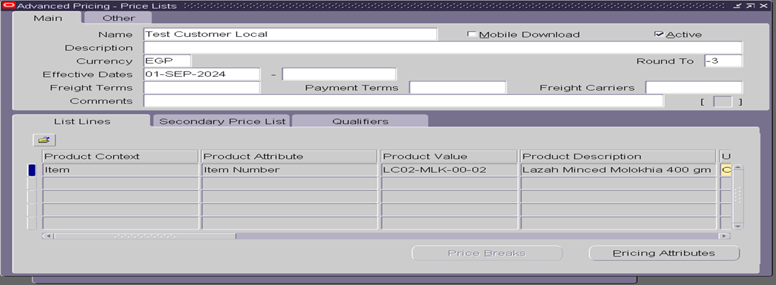
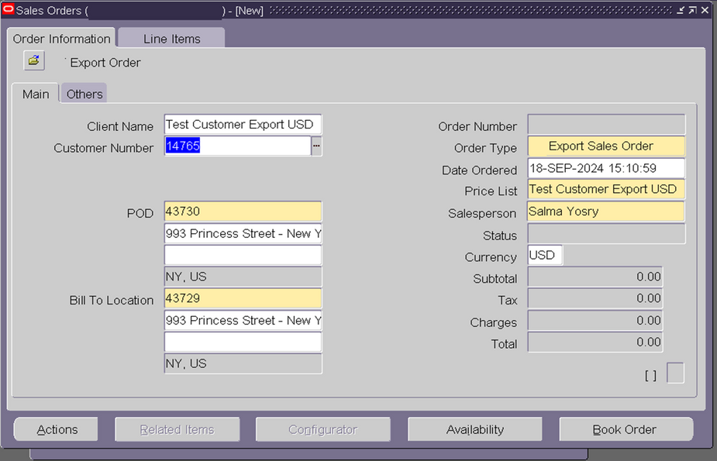
CREATE PRICE LIST

Slide 15
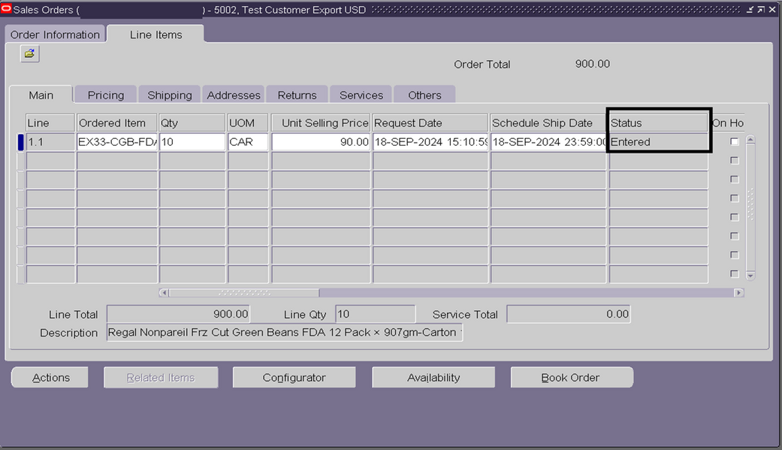
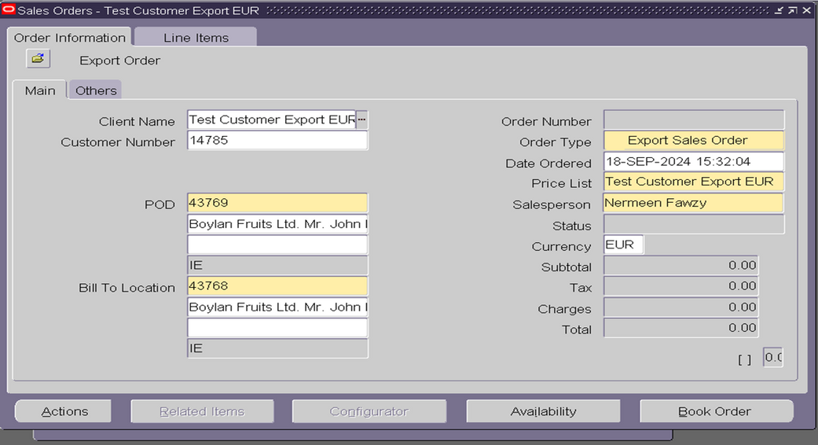
CREATE PRICE LIST

Slide 16
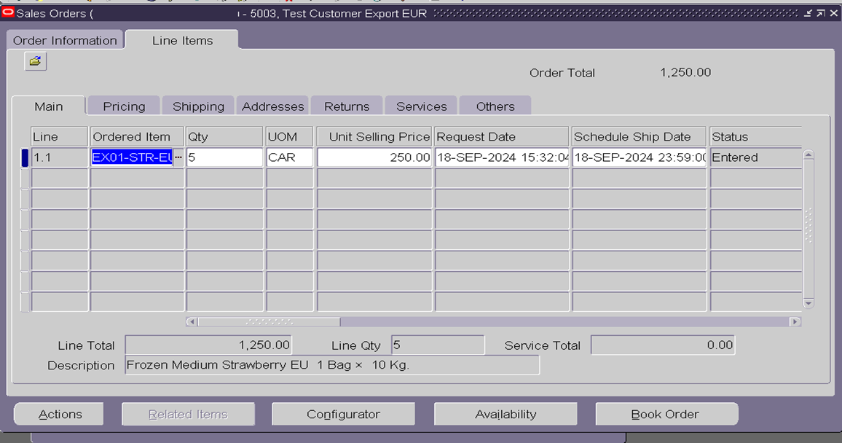
CREATE PRICE LIST

Slide 17
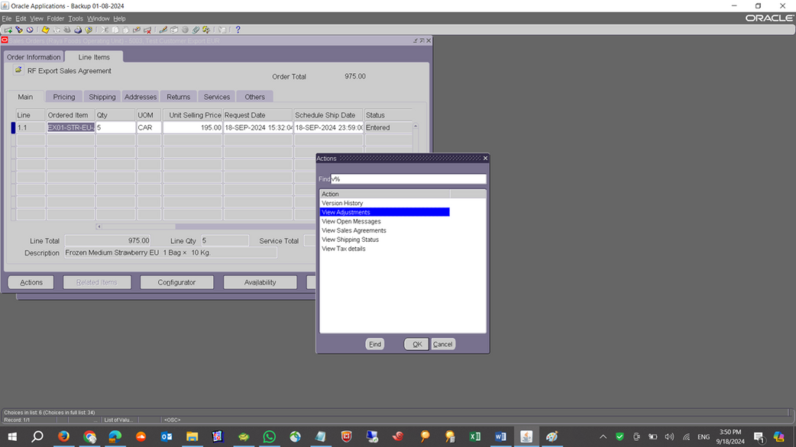
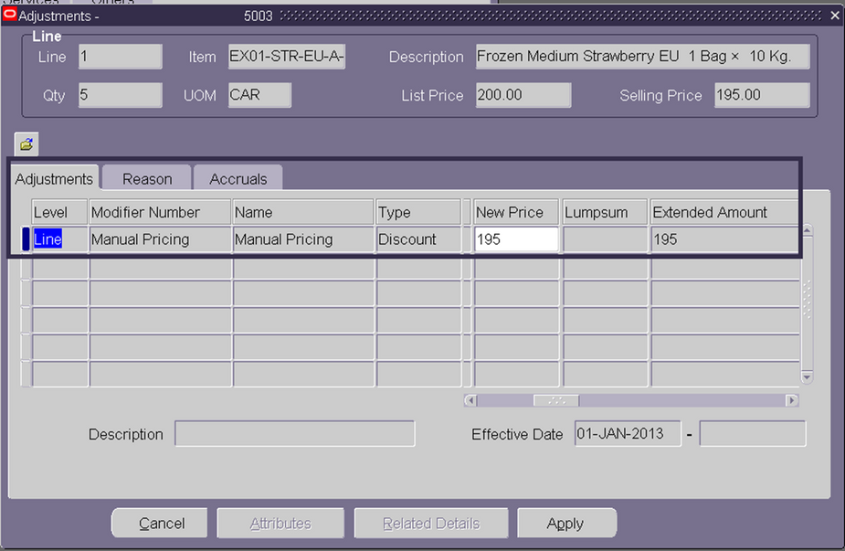
TO VIEW DISCOUNT ON SALES ORDER

Slide 18
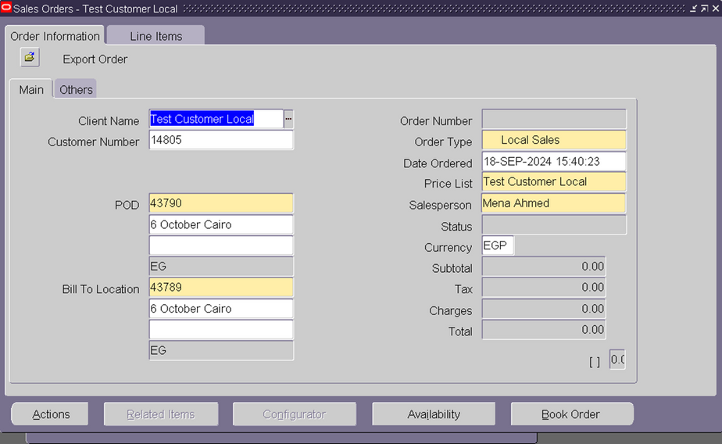
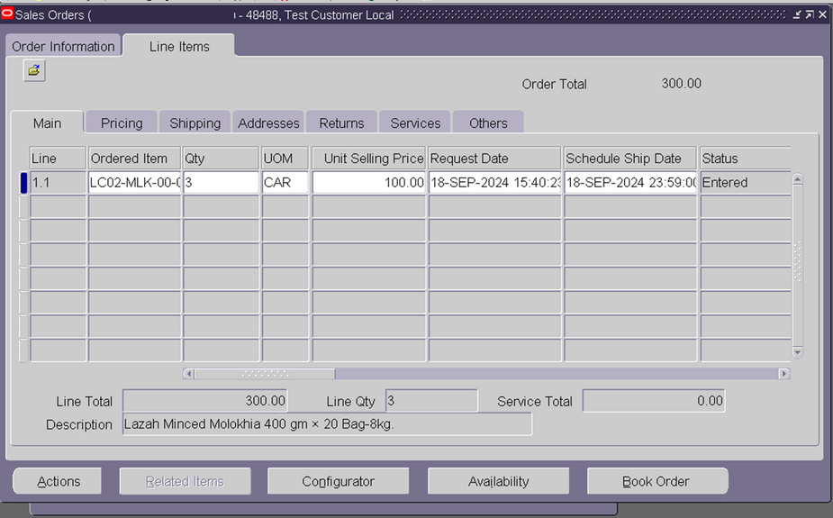
TO VIEW DISCOUNT ON SALES ORDER

Slide 19
ORDER FULFILLMENT WORKFLOW
Order review
inventory allocation
Shipping
Delivery confirmation
real-time tracking
STEPS IN THE ORDER FULFILLMENT PROCESS:
ORDER REVIEW: CHECK STOCK AVAILABILITY AND CONFIRM ORDER DETAILS FROM LOGISTIC TEAM.
INVENTORY ALLOCATION: RESERVE ITEMS FROM INVENTORY.
SHIPPING AND DELIVERY: ASSIGN WAREHOUSE LOCATION AND SCHEDULE SHIPPING.
DELIVERY CONFIRMATION: UPDATE SYSTEM UPON SUCCESSFUL DELIVERY.
REAL-TIME ORDER TRACKING: HOW TO MONITOR ORDER STATUS (PENDING, FULFILLED, SHIPPED)

Slide 20
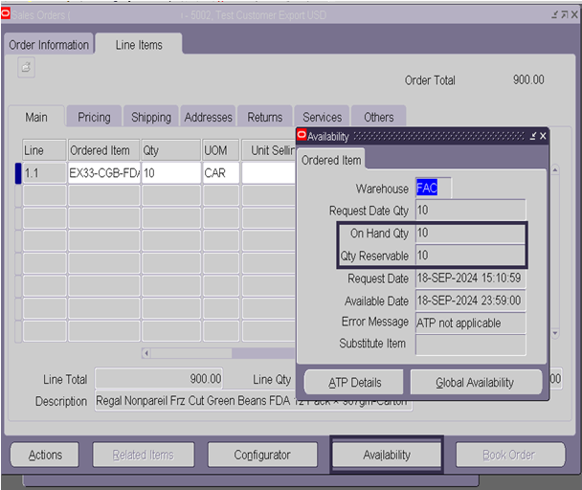
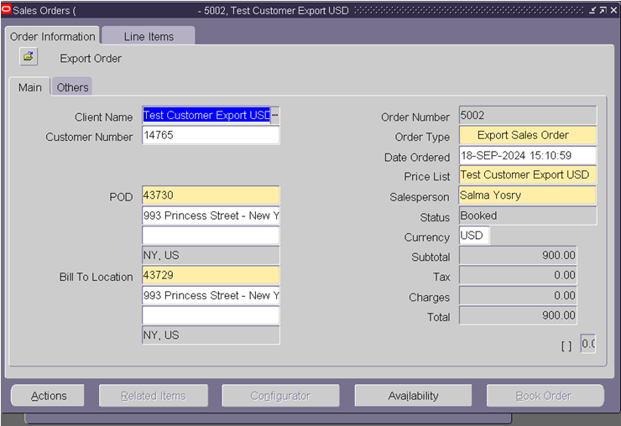
ORDER REVIEW

Slide 21
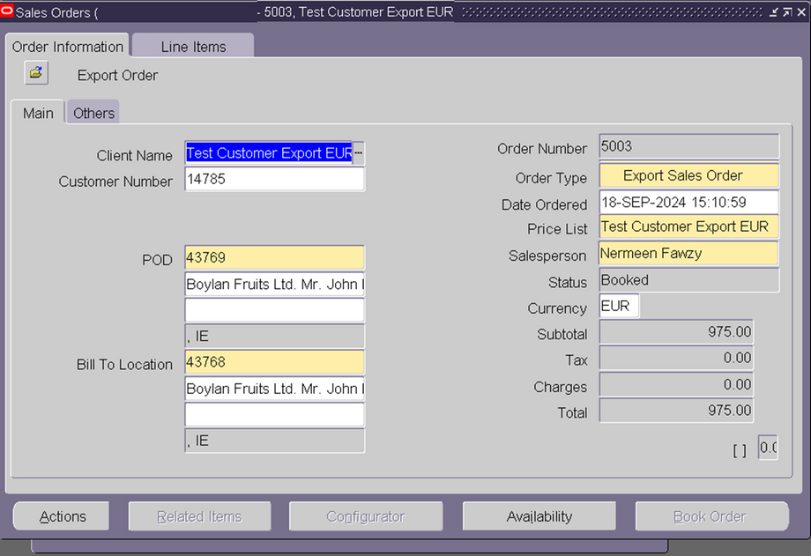
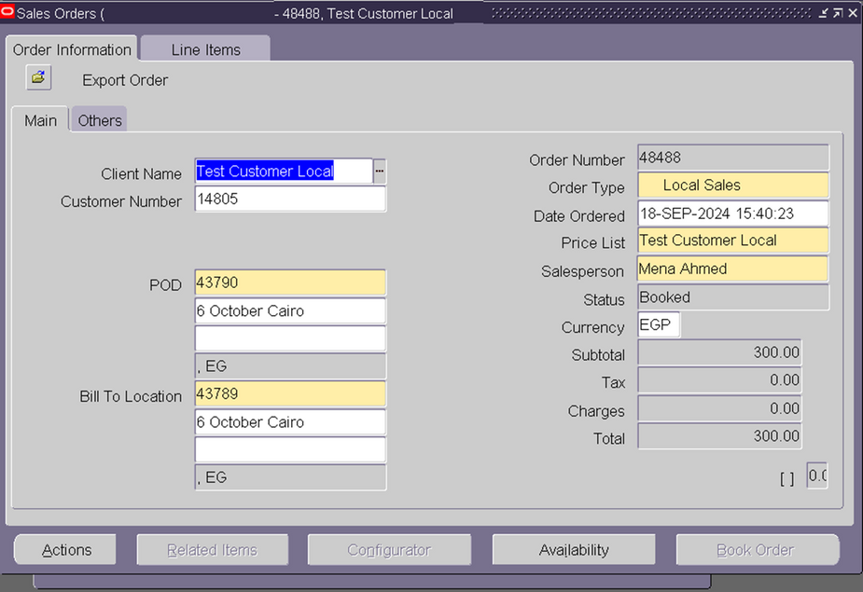
ORDER REVIEW

Slide 22
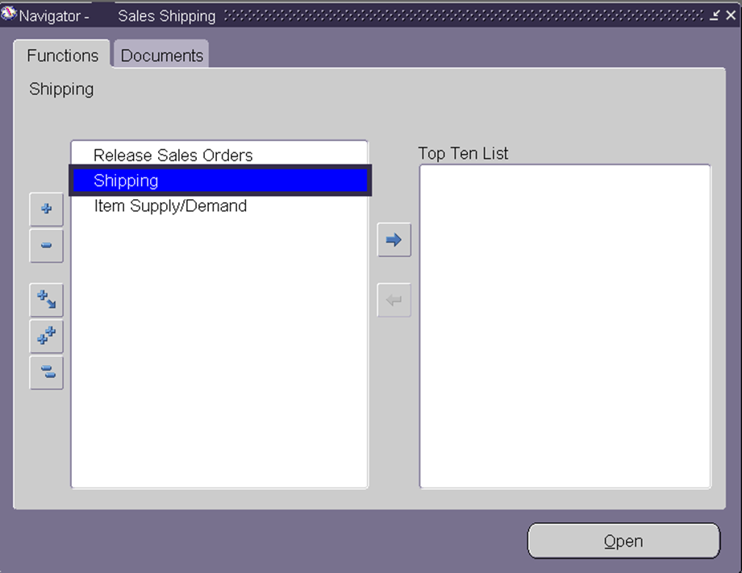
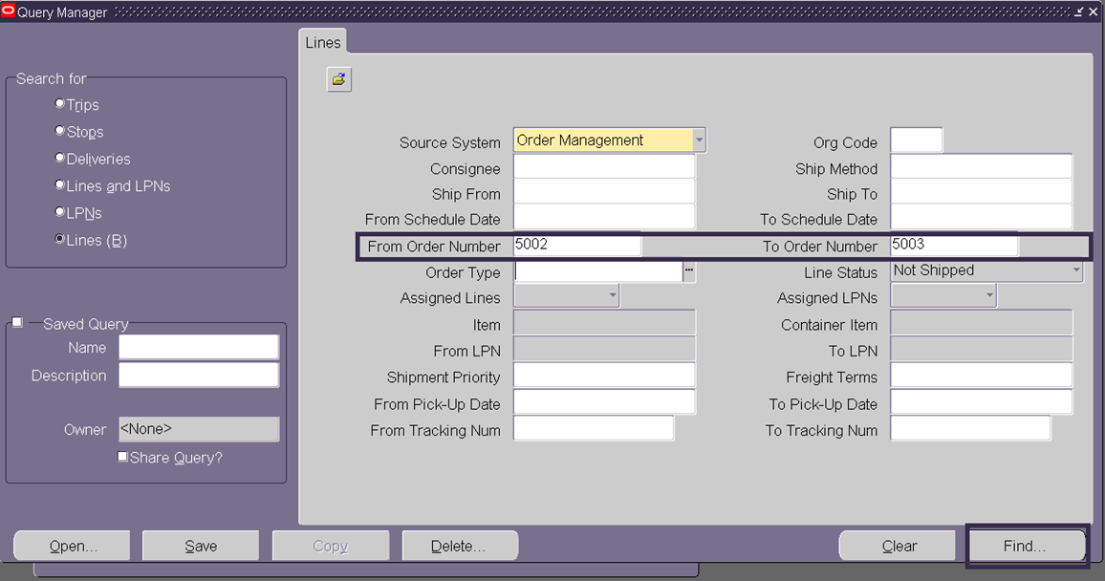
INVENTORY ALLOCATION & SHIPPING AND DELIVERY

Slide 23
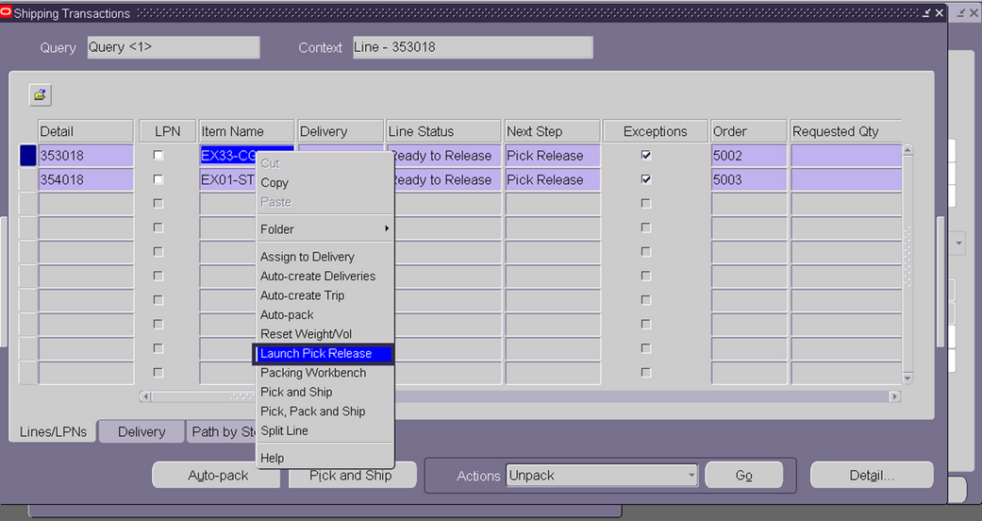
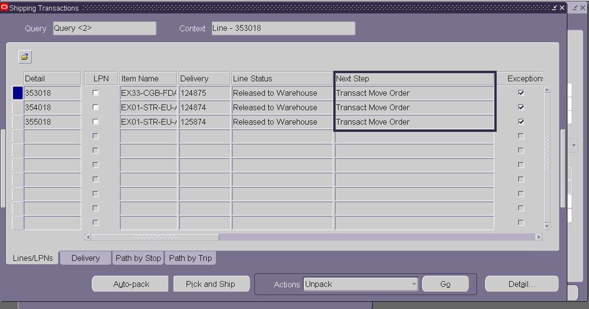
INVENTORY ALLOCATION & SHIPPING AND DELIVERY

Slide 24
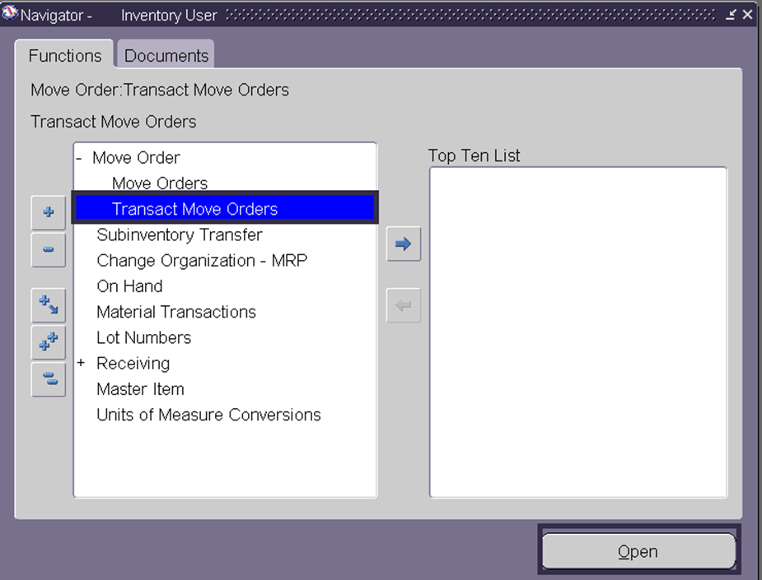
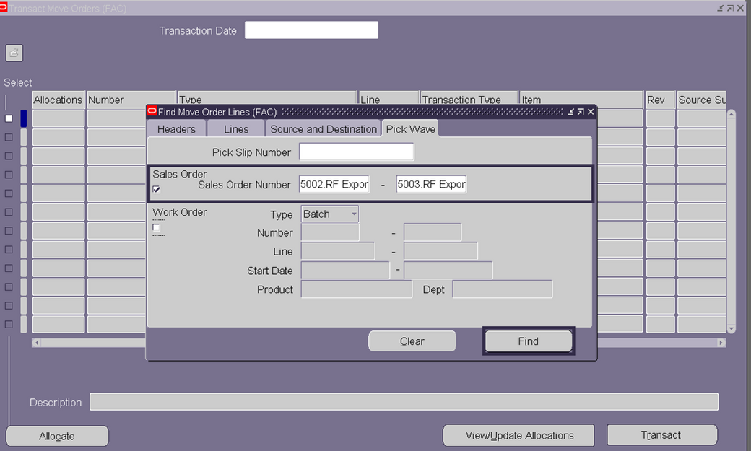
INVENTORY ALLOCATION & SHIPPING AND DELIVERY

Slide 25
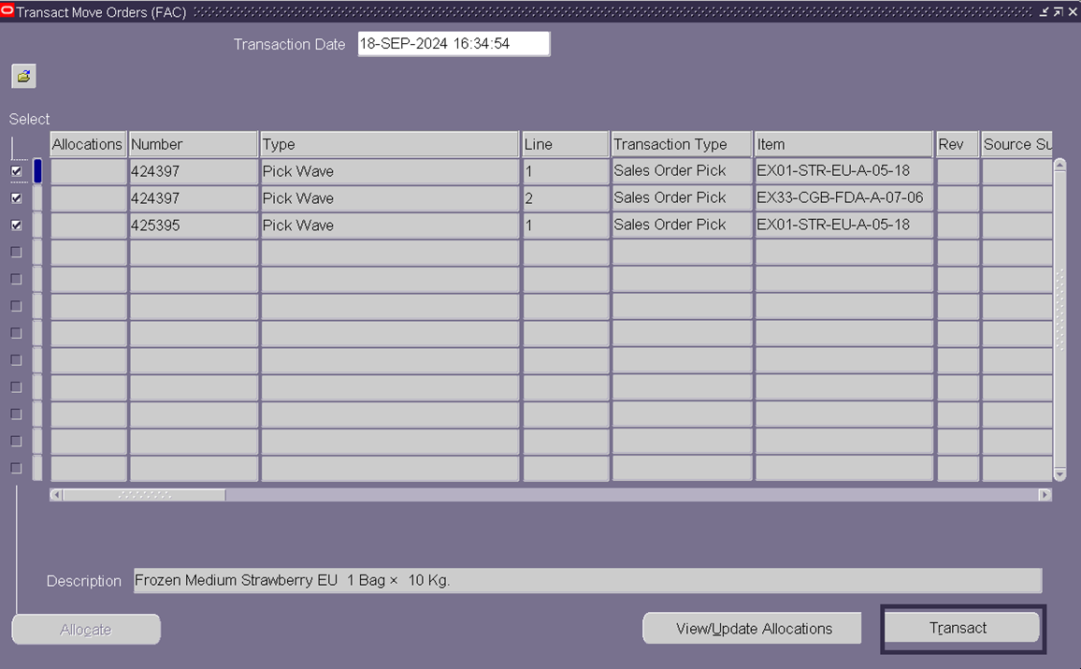
INVENTORY ALLOCATION & SHIPPING AND DELIVERY

Slide 26
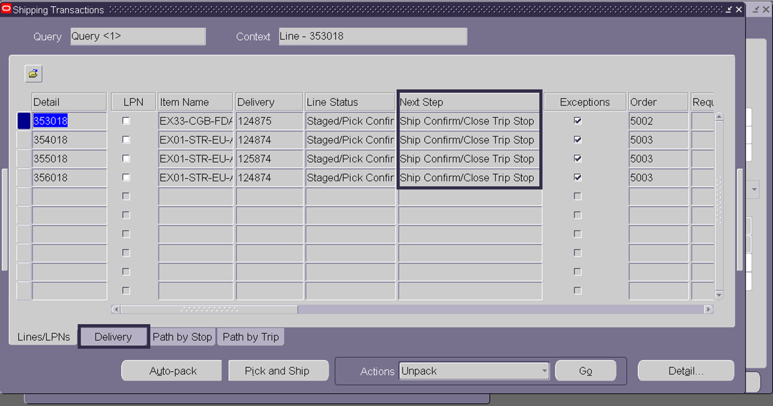
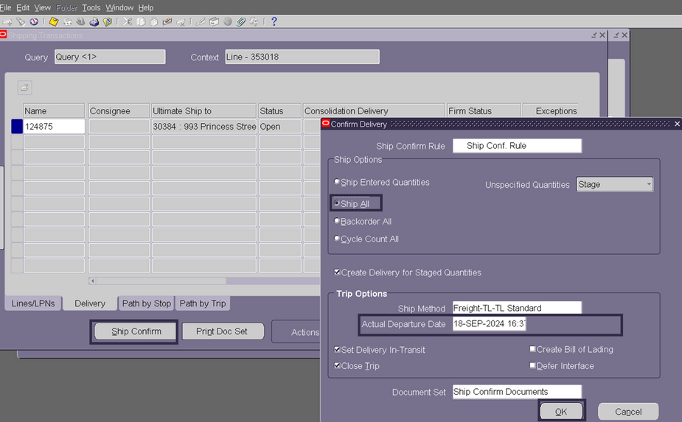
DELIVERY CONFIRMATION

Slide 27
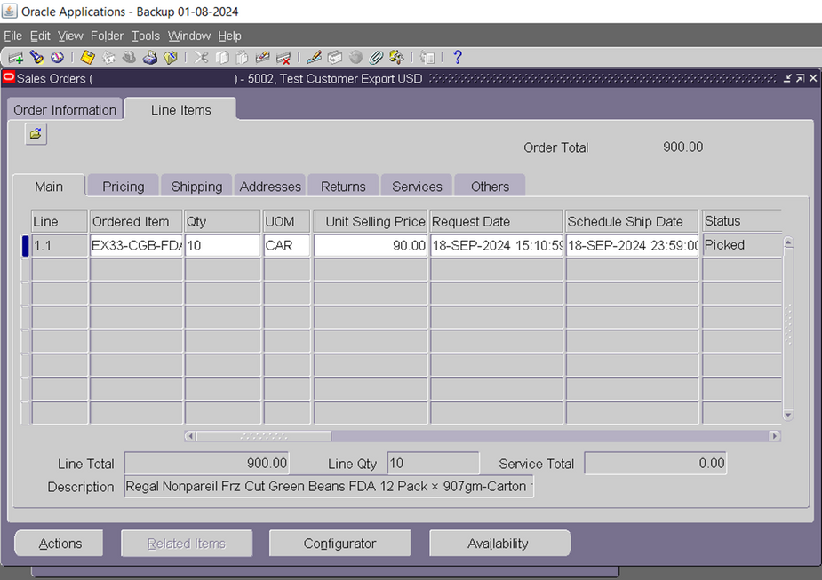
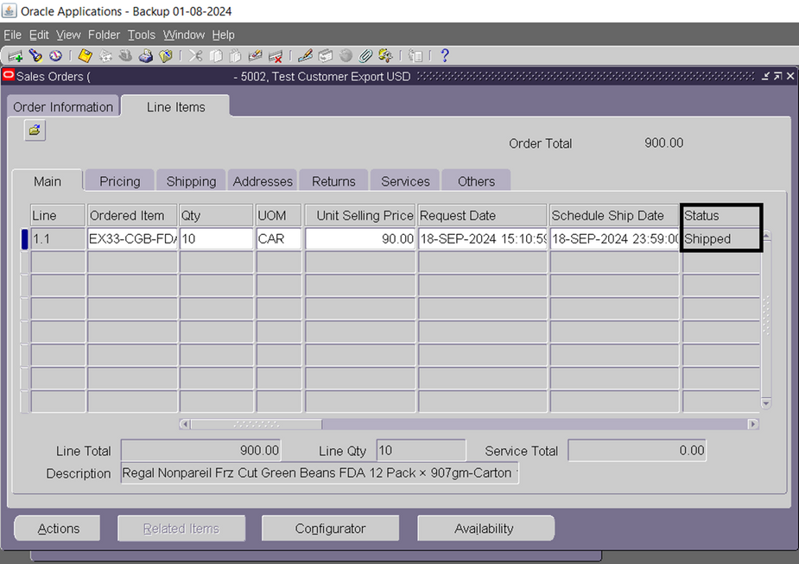
REAL-TIME ORDER TRACKING

Slide 28
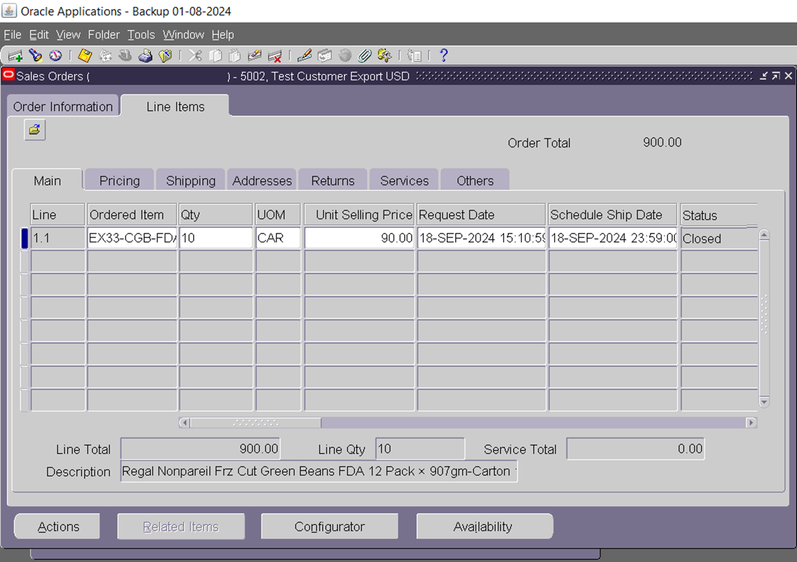
INVENTORY ALLOCATION & SHIPPING AND DELIVERY

Slide 29
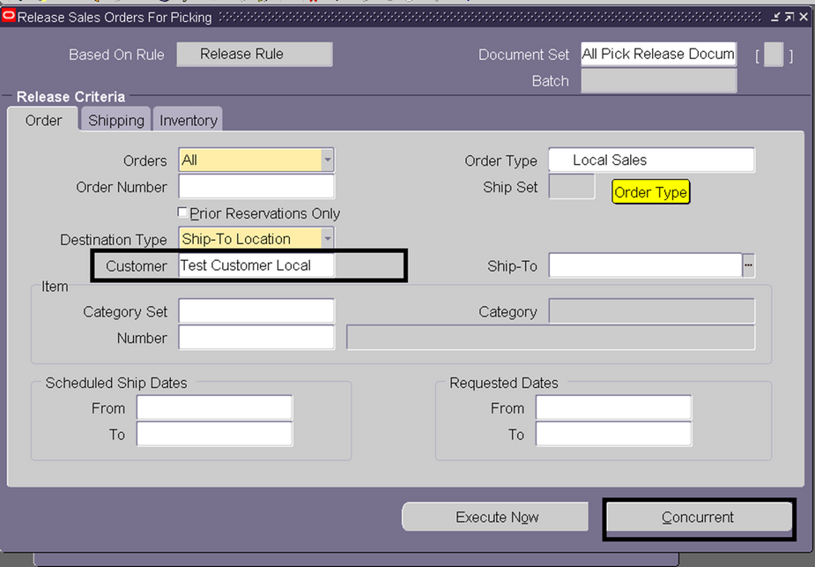
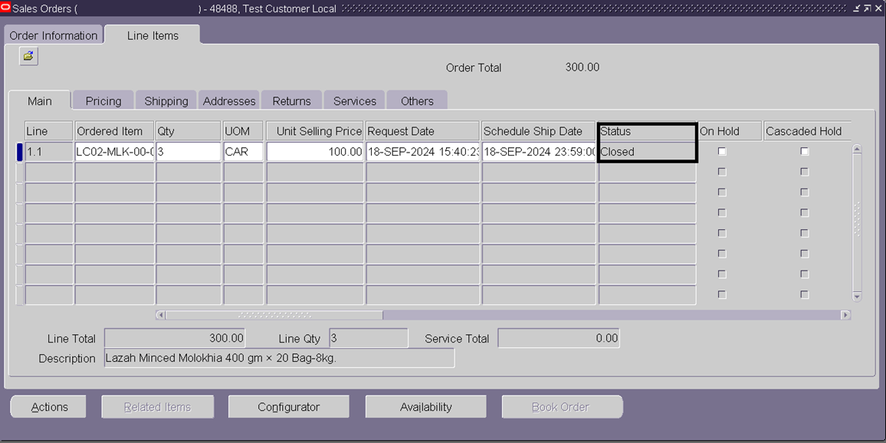
FOR LOCAL SALES ORDER USING RELEASE RULE TO AUTOMATE ALL SHIPPING STAGES

Slide 30
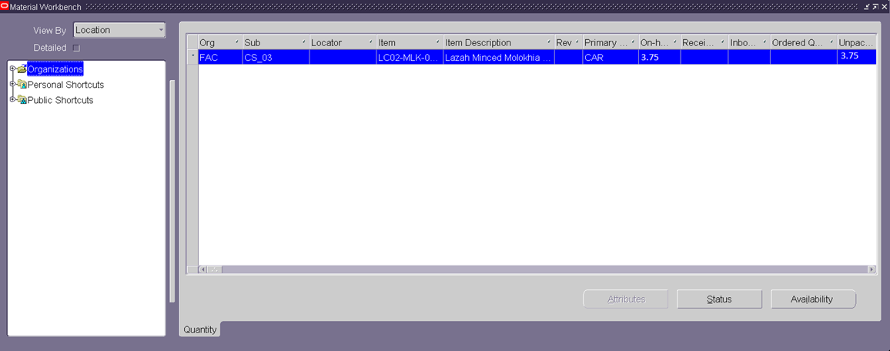
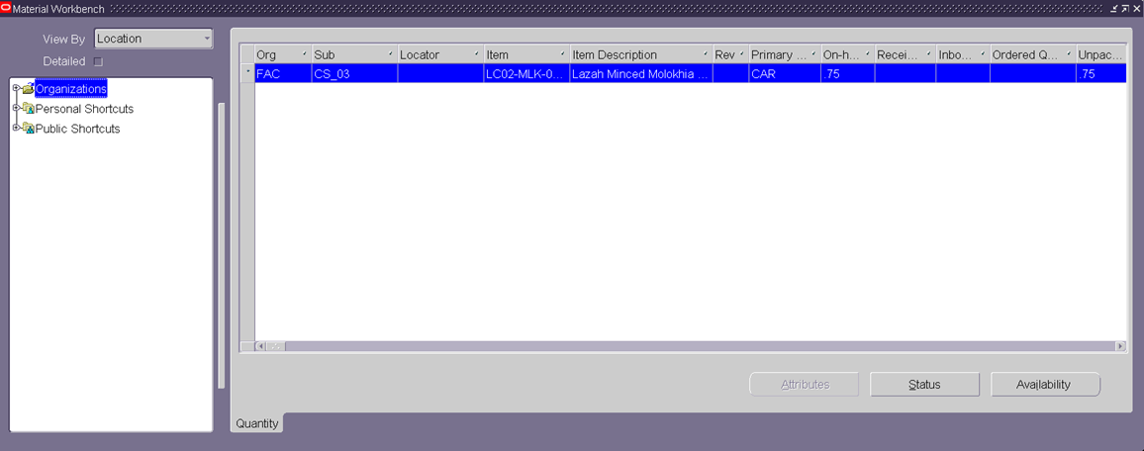
INVENTORY MANAGEMENT INTEGRATION
REPLENISHMENT & TRACKING: AUTOMATIC STOCK REPLENISHMENT AND TRACEABILITY.
CHECKING INVENTORY LEVELS: STOCK REPLENISHMENT: TRIGGERING AUTOMATIC STOCK REPLENISHMENT FOR POPULAR ITEMS.
BEFORE ISSUE LOCAL SALES ORDER
AFTER ISSUE LOCAL SALES ORDER

Slide 31
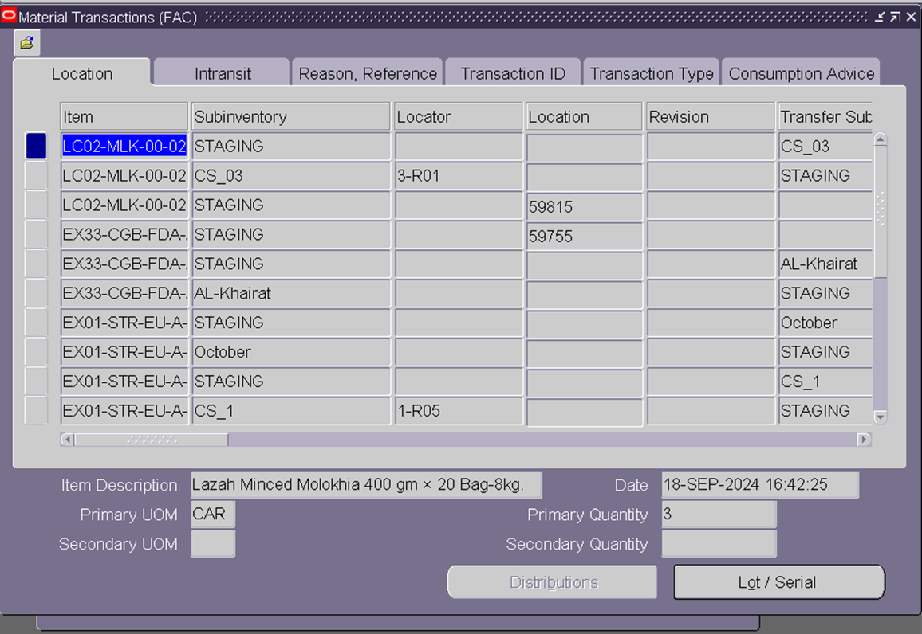
ALL TRANSACTION TRACEABLE

Slide 32
HANDLING RETURNS AND CANCELLATIONS
Steps for Handling Returns: Create order returns, record reasons, and process refunds/replacements.
Order Cancellations: Process before fulfillment.
Returns Process:
Step 1
create order Return
Step 2
Process the return request by selecting the item to return
Step 3
Record the reason for return and initiate the return shipment.
Step 4
Issue refunds or replacements

Slide 33
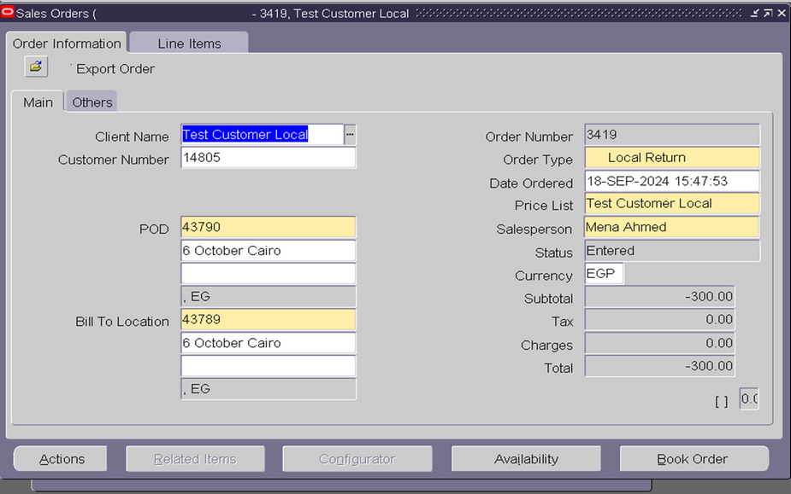
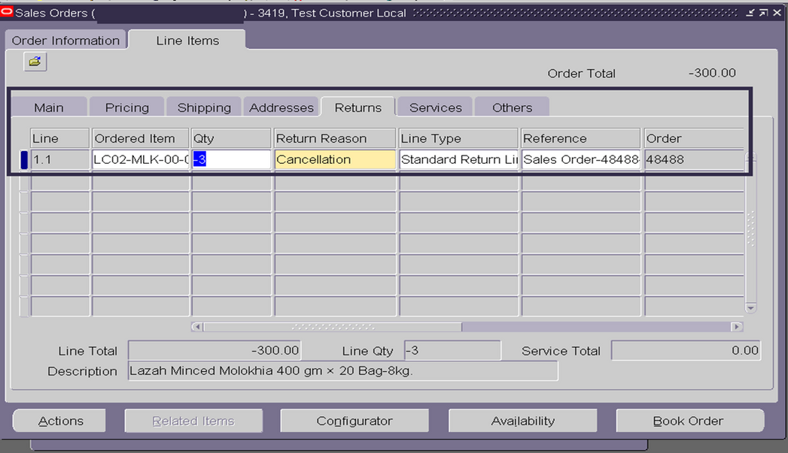
HANDLING RETURNS AND CANCELLATIONS

Slide 34

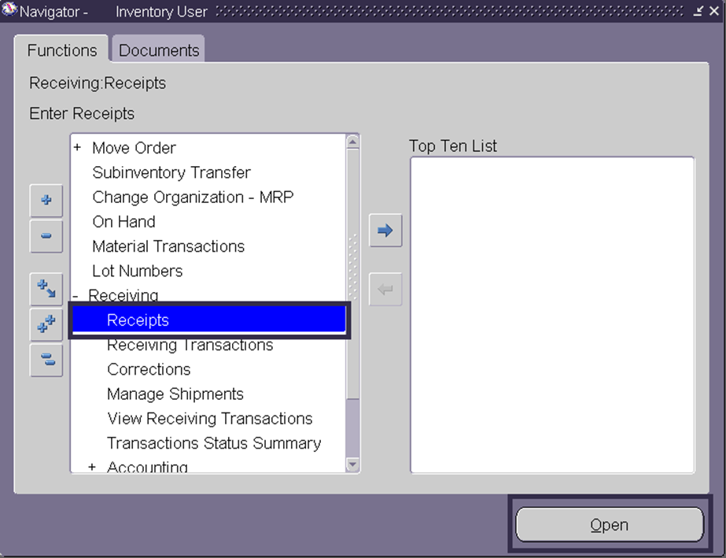
HANDLING RETURNS AND CANCELLATIONS

Slide 35
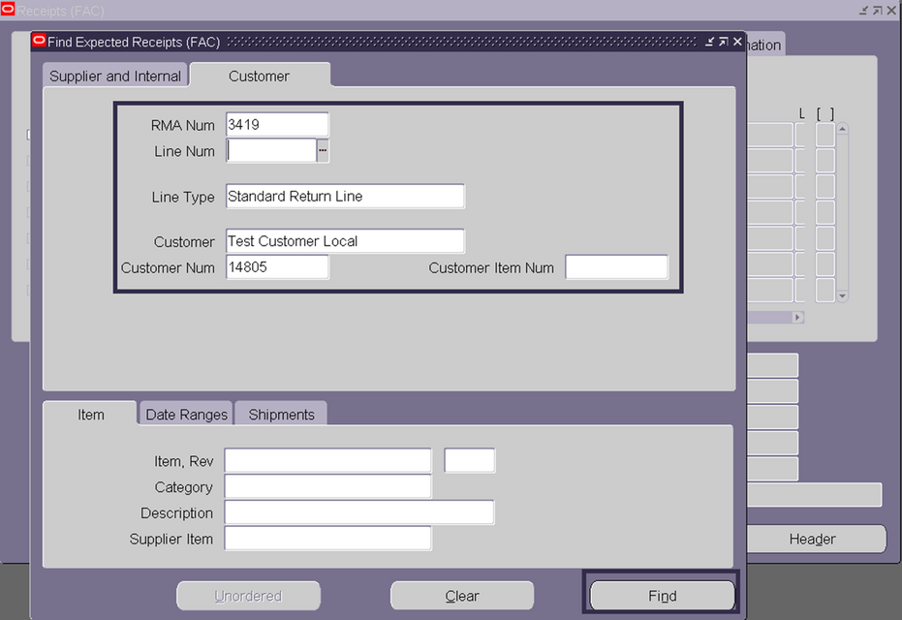
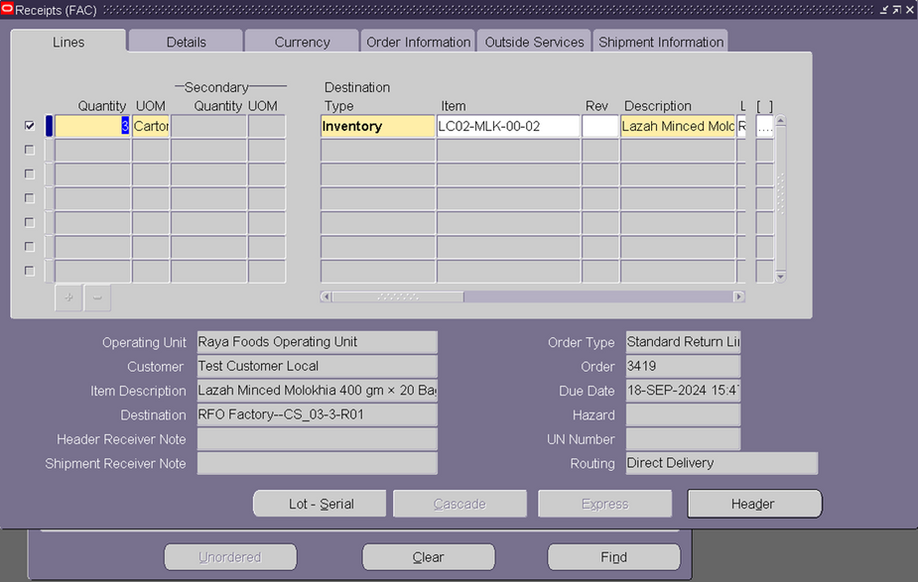
HANDLING RETURNS AND CANCELLATIONS

Slide 36
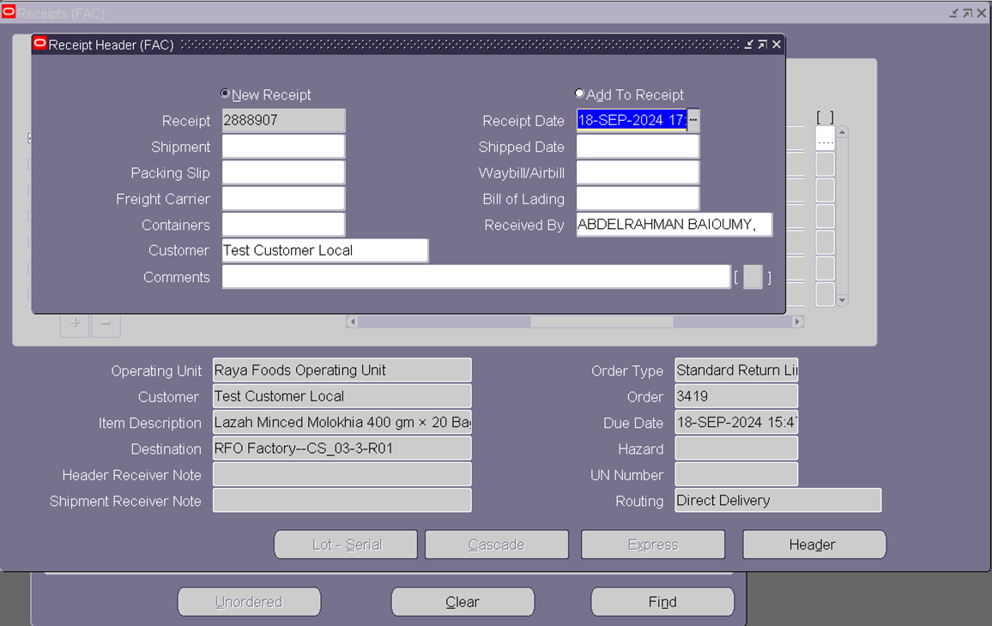
ALL TRANSACTION TRACEABLE

Slide 37
BEFORE RETURN LOCAL SALES ORDER
AFTER RETURN LOCAL SALES ORDER

Slide 38
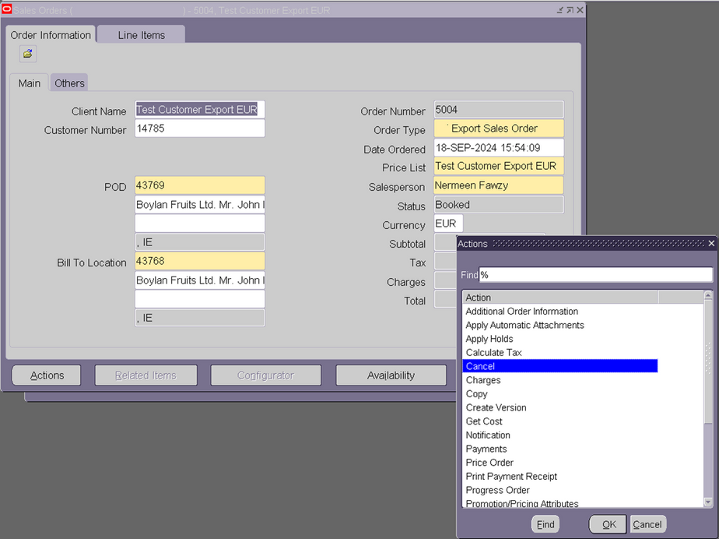
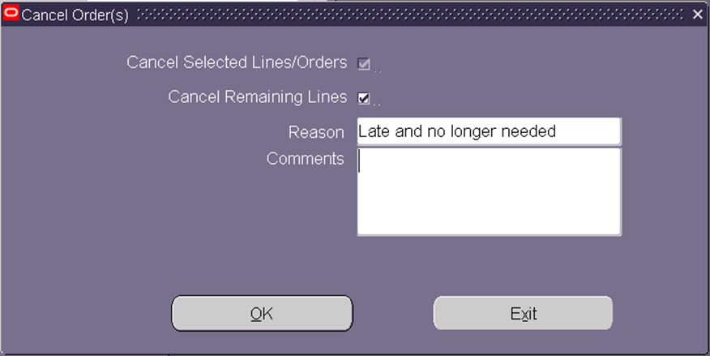
ORDER CANCELLATIONS:
CANCELLING AN ORDER PRIOR TO FULFILLMENT.

Slide 39
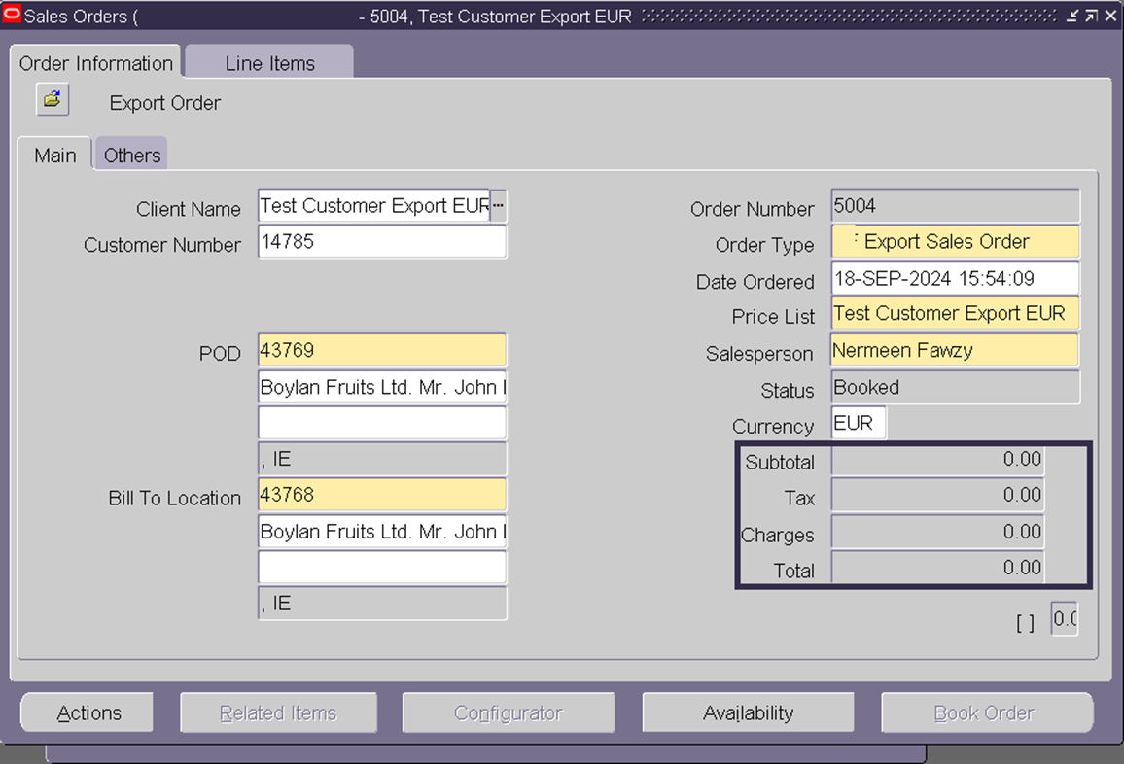
ORDER CANCELLATIONS:
CANCELLING AN ORDER PRIOR TO FULFILLMENT.

Slide 40

THANK YOU
FOR YOUR ATTENTION
READY FOR QUESTIONS

